Slide 1

Time-series, PostgreSQL, and You
Mathis Van Eetvelde
PGConf NYC 2022
Notes:
Cover
Fonts used throughout presentation:
Regular text: Inter (https://fonts.google.com/specimen/Inter)
Numbers: Source code pro (https://fonts.google.com/specimen/Source+Code+Pro )

Slide 2

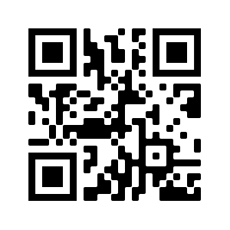





About me
@meetvelde
@mathisve
Mathis Van Eetvelde
mathisvaneetvelde.com
Mathis Van Eetvelde
Developer Advocate
@Timescale
Notes:
Used for introducing two people. Follow this quick tutorial to crop images into a circle: https://youtu.be/5mM8l8S9LdY

Slide 3
Agenda
01
What is time-series data
Topics we will cover today
02
Time-series data on PostgreSQL
03
Time-series data and You
03.1
TimescaleDB
Notes:
Agenda items. Looks best up to 6 topics

Slide 4
What is time-series data?
01
Notes:
Time series data is any kind of data where time plays an important role.
Most commonly time series data tracks something that changes over time.

Slide 5
Time-series DDL
Code sample
Financial time-series data
CREATE TABLE stocks (
time TIMESTAMPTZ NOT NULL,
price INT NULL,
symbol TEXT NULL
);
IoT time-series data
CREATE TABLE measurements (
time TIMESTAMPTZ NOT NULL,
deviceID INT NULL,
sensor_value REAL NULL,
location geometry NULL
);
…
Notes:
Alternate light version for displaying code snippets.

Slide 6
Financial data
Stocks
OLTP (Online Transaction Processing)
IoT data
Smartphones
Smart fridges, TVs, etc.
Industrial sensors
Observability data
Traces, spans
Logs
Metrics
Kinds of time-series data
Notes:
Use for displaying key points

Slide 7
Time-series data means scale
NYSE transactions per day
NYSE transactions per second
NYSE transactions in 5 years
4.2B
162K
5.4T
Consolidated Tape A
trading volume
https://www.nyse.com/markets/us-equity-volumes
4.2B Transactions
23400 Trading Seconds
CFTC requires that financial records be kept for 5 years and “readily available” for
2 years
Notes:
Used when you want to highlight 3 statistics.

Slide 8
Time-series data
on PostgreSQL
02
Notes:
Headers for each item on agenda (try to keep to 1-2 lines)
Font: Inter bold + blue recommended
Feel free to duplicate to add more sections!

Slide 9

Flourishing ecosystem
Tried and tested
Not a DSL (InfluxQL, FQL, etc.)
You don’t have to write your own JOINs on the application level
You already know PostgreSQL
Why PostgreSQL?
Notes:
Use for displaying key points

Slide 10
4.2 Billion databases
1.4 Billion tables per database
32 TB per table (8192 bytes block size)
4.2 Billion pages per table
Hard limitations of PostgreSQL
Notes:
Use for displaying key points

Slide 11
Partitioning
32TB Table
Notes:
Use for displaying key points

Slide 12
Partitioning
Root Table
8TB Table
8TB Table
8TB Table
8TB Table
Notes:
Use for displaying key points

Slide 13
Smaller tables
Smaller indexes
Partition Pruning
Partitioning
Notes:
Use for displaying key points

Slide 14
Inheritance based partitioning (pre PG 10)
Harder
Versatile
Declarative partitioning since (PG 10)
Easier
Partitioning
Notes:
Use for displaying key points

Slide 15
Inheritance based partitioning
Code sample
Create the root table
CREATE TABLE measurement (
time TIMESTAMPTZ NOT NULL,
sensorID INT NULL,
sensor_value REAL NULL
);
Create inheritance tables
CREATE TABLE measurement_y2022m01 () INHERITS (measurement);
CREATE TABLE measurement_y2022m02 () INHERITS (measurement);
CREATE TABLE measurement_y2022m03 () INHERITS (measurement);
Create indexes
CREATE INDEX ON measurement_y2022m01 (time);
CREATE INDEX ON measurement_y2022m02 (time);
CREATE INDEX ON measurement_y2022m03 (time);
Notes:
Alternate light version for displaying code snippets.

Slide 16
-
Trigger function
Code sample
CREATE OR REPLACE FUNCTION measurement_insert_trigger()
RETURNS TRIGGER AS $$
BEGIN
IF ( NEW.time >= DATE '2022-01-01' AND
NEW.time < DATE '2022-02-01' ) THEN
INSERT INTO measurement_y2022m01 VALUES (NEW.*);
…
ELSIF ( NEW.time >= DATE '2022-03-01' AND
NEW.time < DATE '2022-04-01' ) THEN
INSERT INTO measurement_y2022m03 VALUES (NEW.*);
ELSE
RAISE EXCEPTION 'Date out of range.';
END IF;
RETURN NULL;
END;
$$
LANGUAGE plpgsql;
CREATE TRIGGER insert_measurement_trigger
BEFORE INSERT ON measurement
FOR EACH ROW EXECUTE FUNCTION measurement_insert_trigger();
Notes:
Alternate light version for displaying code snippets.

Slide 17
-
Inserts
Code sample
INSERT INTO measurement (time, sensorID, sensor_value) VALUES ('2022-01-3', 2, 2.9);
INSERT INTO measurement (time, sensorID, sensor_value) VALUES ('2022-01-6', 1, 3.5);
…
INSERT INTO measurement (time, sensorID, sensor_value) VALUES ('2022-03-27', 3, 2.5);
INSERT INTO measurement (time, sensorID, sensor_value) VALUES ('2022-03-29', 2, 5.3);
SELECT tableoid, * from measurement;
tableoid | time | sensorid | sensor_value
-----------+------------------------+----------+--------------
19103 | 2022-01-03 00:00:00+00 | 2 | 2.9
19103 | 2022-01-06 00:00:00+00 | 1 | 3.5
… | … | … | …
19109 | 2022-03-27 00:00:00+00 | 3 | 2.5
19109 | 2022-03-29 00:00:00+00 | 2 | 5.3
Notes:
Alternate light version for displaying code snippets.

Slide 18
-
Partition Pruning - on
Code sample
SET enable_partition_pruning = on; -- default
EXPLAIN ANALYZE SELECT * FROM measurement WHERE time > '2022-03-01';
Index Scan using measurementy2022m03_time_idx on measurementy2022m03 measurement (cost=0.15..23.05 rows=617 width=16) (actual time=0.005..0.006 rows=5 loops=1)
Index Cond: ("time" > '2022-03-01 00:00:00+00'::timestamp with time zone)
Planning Time: 0.090 ms
Execution Time: 0.019 ms
(4 rows)
Notes:
Alternate light version for displaying code snippets.

Slide 19
-
Partition Pruning - off
Code sample
SET enable_partition_pruning = off;
EXPLAIN ANALYZE SELECT * FROM measurement WHERE time > '2022-03-01';
Append (cost=0.15..78.41 rows=1851 width=16) (actual time=0.031..0.033 rows=5 loops=1)
-> Index Scan using measurementy2022m01_time_idx on measurementy2022m01 measurement_1
Index Cond: ("time" > '2022-03-01 00:00:00+00'::timestamp with time zone)
-> Index Scan using measurementy2022m02_time_idx on measurementy2022m02 measurement_2
Index Cond: ("time" > '2022-03-01 00:00:00+00'::timestamp with time zone)
-> Index Scan using measurementy2022m03_time_idx on measurementy2022m03 measurement_3
Index Cond: ("time" > '2022-03-01 00:00:00+00'::timestamp with time zone)
Planning Time: 0.123 ms
Execution Time: 0.053 ms
(9 rows)
Notes:
Alternate light version for displaying code snippets.

Slide 20
Declarative Partitioning
Code sample
Create the root table
CREATE TABLE measurement (
time TIMESTAMPTZ NOT NULL,
sensorID INT NULL,
sensor_value REAL NULL
) PARTITION BY RANGE (time);
Create partitions
CREATE TABLE measurementy2022m01 PARTITION OF measurement
FOR VALUES FROM ('2022-01-01') TO ('2022-02-01');
CREATE TABLE measurementy2022m02 PARTITION OF measurement
FOR VALUES FROM ('2022-02-01') TO ('2022-03-01');
CREATE TABLE measurementy2022m03 PARTITION OF measurement
FOR VALUES FROM ('2022-03-01') TO ('2022-04-01');
Notes:
Alternate light version for displaying code snippets.

Slide 21
-
Inserts
Code sample
INSERT INTO measurement (time, sensorID, sensor_value) VALUES ('2022-01-3', 2, 2.9);
INSERT INTO measurement (time, sensorID, sensor_value) VALUES ('2022-01-6', 1, 3.5);
…
INSERT INTO measurement (time, sensorID, sensor_value) VALUES ('2022-03-27', 3, 2.5);
INSERT INTO measurement (time, sensorID, sensor_value) VALUES ('2022-03-29', 2, 5.3);
SELECT tableoid, * from measurement;
tableoid | time | sensorid | sensor_value
-----------+------------------------+----------+--------------
18918 | 2022-01-03 00:00:00+00 | 2 | 2.9
18918 | 2022-01-06 00:00:00+00 | 1 | 3.5
… | … | … | …
18924 | 2022-03-27 00:00:00+00 | 3 | 2.5
18924 | 2022-03-29 00:00:00+00 | 2 | 5.3
Notes:
Alternate light version for displaying code snippets.

Slide 22
-
Indexes
Code sample
CREATE INDEX ON measurement (time);
SELECT
tablename, indexname
FROM
pg_indexes
WHERE
tablename LIKE 'measurement%';
tablename | indexname
---------------------+------------------------------
measurement | measurement_time_idx
measurementy2022m01 | measurementy2022m01_time_idx
measurementy2022m02 | measurementy2022m02_time_idx
measurementy2022m03 | measurementy2022m03_time_idx
Notes:
Alternate light version for displaying code snippets.

Slide 23
Range partitioning
List partitioning
Hash partitioning
Composite partitioning
Declarative
partitioning
Notes:
Use for displaying key points

Slide 24
Time-series data and You
03
Notes:
Headers for each item on agenda (try to keep to 1-2 lines)
Font: Inter bold + blue recommended
Feel free to duplicate to add more sections!

Slide 25
Solutions
Manual labor
Diy bash script
pg_partman & pg_cron
Notes:
Alternate light version for displaying code snippets.

Slide 26
TimescaleDB
Postgres for time-series
Notes:
This is an internal cover. Used when you need large text and it is not a section header. E.g. “Welcome” “Questions?” “Thank you!” “Shout Outs” etc
Font: Inter bold + navy recommended

Slide 27
Quick install
Install using your favorite package manager
apt install timescaledb-2-postgresql-14
yum install timescaledb-2-postgresql-14
sudo pacman -Syu timescaledb timescaledb-tune
Use TimescaleDB in a container
docker run -d --name timescaledb -p 5432:5432
Or install from source
git clone https://github.com/timescale/timescaledb.git
cd timescaledb
git checkout 2.5.1
./bootstrap
cd build && make
make install
https://docs.timescale.com/install/latest/
Notes:
Alternate light version for displaying code snippets.

Slide 28

TimescaleDB
Create a table
CREATE TABLE measurement (
time TIMESTAMPTZ NOT NULL,
sensorID INT NULL,
sensor_value REAL NULL
);
Create a hypertable
SELECT create_hypertable('measurement','time');
Create a distributed hypertable
SELECT create_distributed_hypertable('measurement', 'time', 'sensorID');
Notes:
Alternate light version for displaying code snippets.

Slide 29
-
Inserts
Code sample
INSERT INTO measurement (time, sensorID, sensor_value) VALUES ('2022-01-3', 2, 2.9);
INSERT INTO measurement (time, sensorID, sensor_value) VALUES ('2022-01-6', 1, 3.5);
…
INSERT INTO measurement (time, sensorID, sensor_value) VALUES ('2022-03-27', 3, 2.5);
INSERT INTO measurement (time, sensorID, sensor_value) VALUES ('2022-03-29', 2, 5.3);
SELECT tableoid, * from measurement;
tableoid | time | sensorid | sensor_value
----------+------------------------+----------+--------------
19204 | 2022-01-03 00:00:00+00 | 2 | 2.9
19210 | 2022-01-06 00:00:00+00 | 1 | 3.5
19216 | 2022-01-15 00:00:00+00 | 3 | 6.2
19222 | 2022-01-23 00:00:00+00 | 1 | 3.2
… | … | … | …
19240 | 2022-02-13 00:00:00+00 | 2 | 2.6
19246 | 2022-02-24 00:00:00+00 | 2 | 1.7
19246 | 2022-02-28 00:00:00+00 | 1 | 6.1
19252 | 2022-03-06 00:00:00+00 | 3 | 5.2
19252 | 2022-03-08 00:00:00+00 | 2 | 2.3
Notes:
Alternate light version for displaying code snippets.

Slide 30
-
Auxiliary functions
Code sample
SELECT show_chunks('measurement');
SELECT drop_chunks('measurement', INTERVAL '5 months');
SELECT reorder_chunk('_timescaledb_internal._hyper_4_78_chunk', 'measurement_time_idx');
SELECT attach_tablespace('disk2', 'measurement');
SELECT move_chunk(
chunk => '_timescaledb_internal._hyper_4_78_chunk',
destination_tablespace => 'disk2',
index_destination_tablespace => 'disk2',
reorder_index => 'measurement_time_idx',
);
https://docs.timescale.com/api/latest/hypertable/
Notes:
Alternate light version for displaying code snippets.

Slide 31
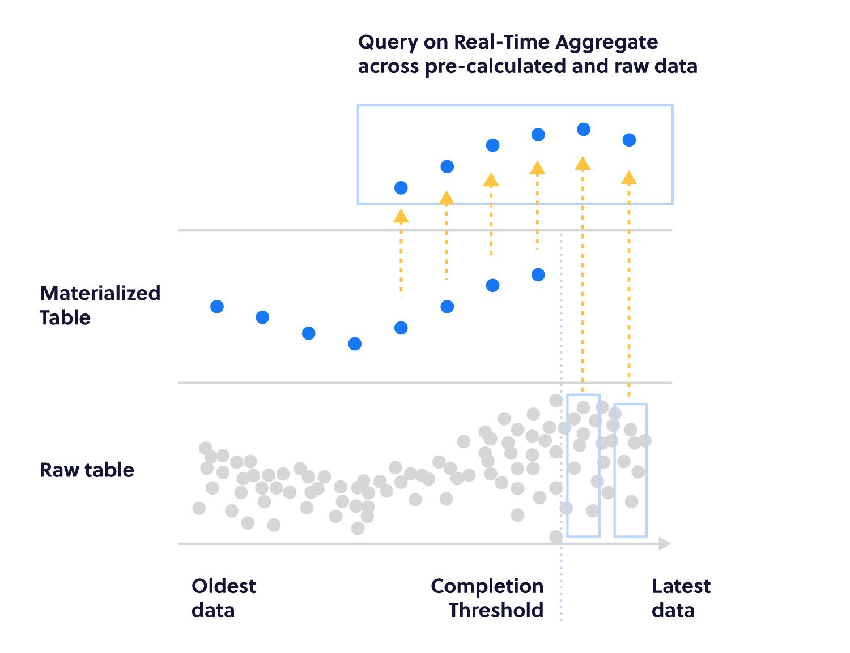
-
Continuous aggregates
Code sample
Notes:
Alternate light version for displaying code snippets.

Slide 32
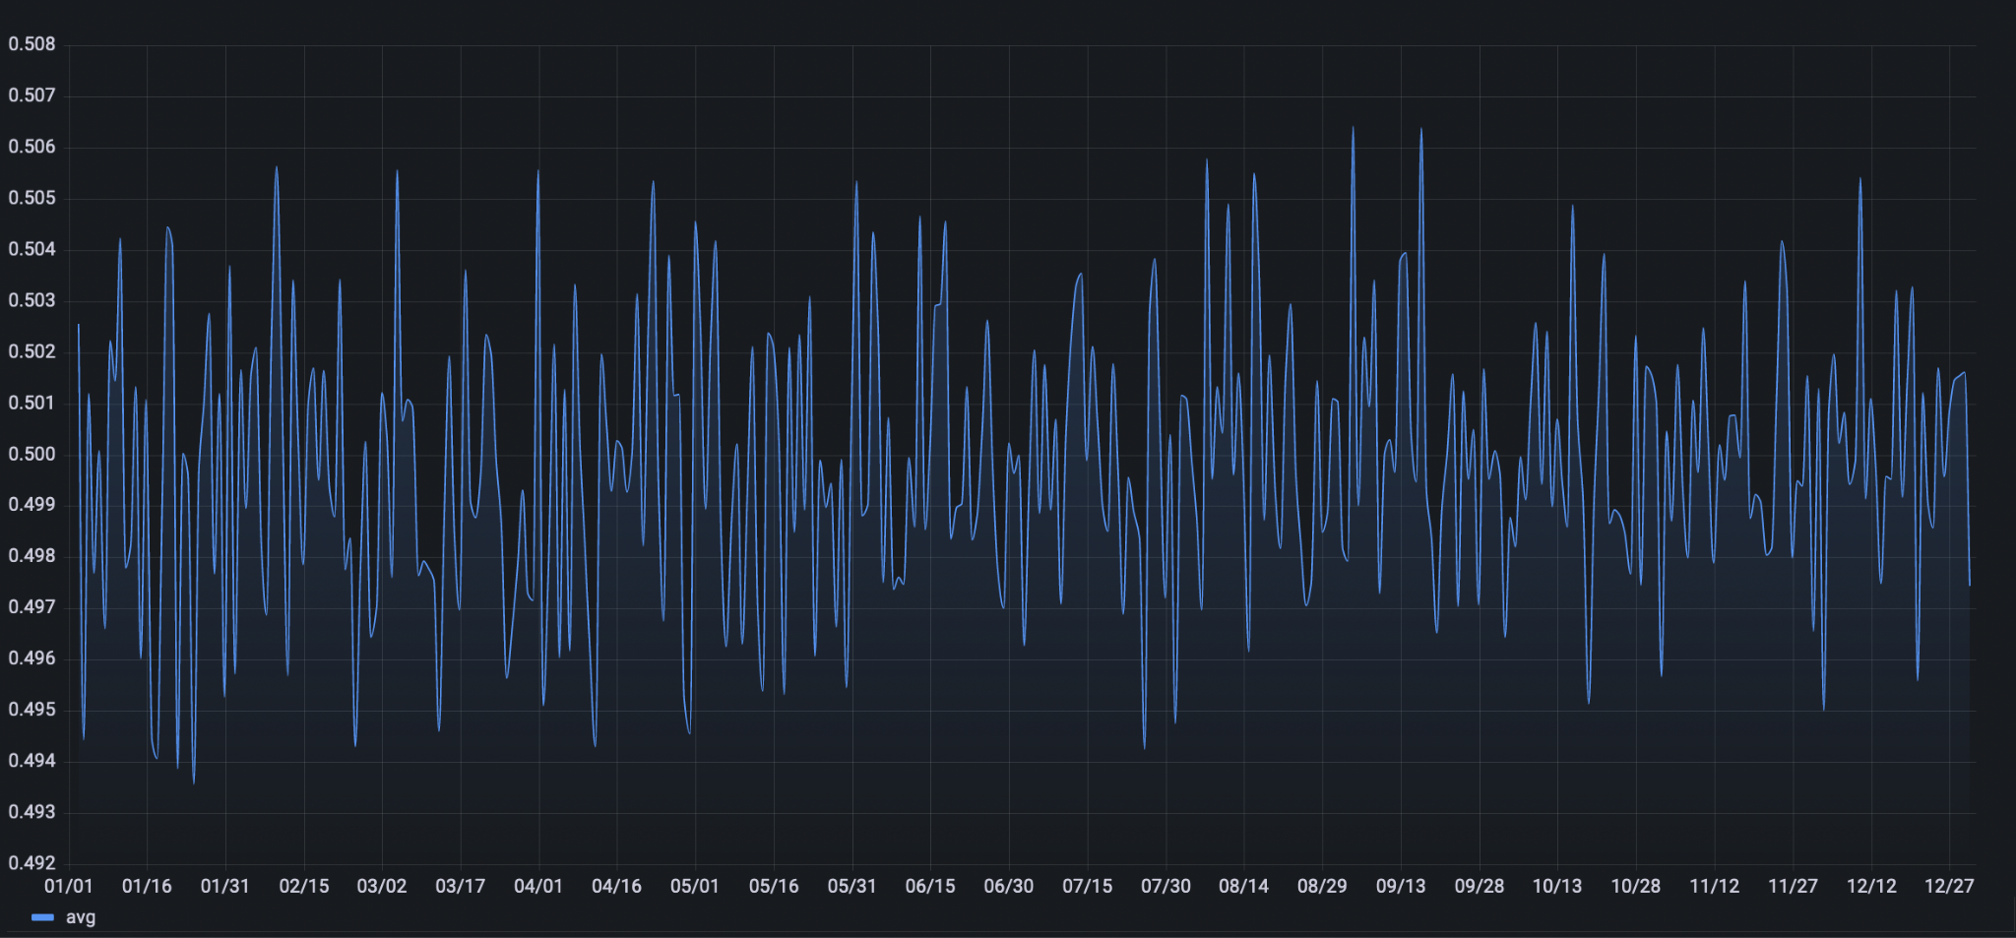
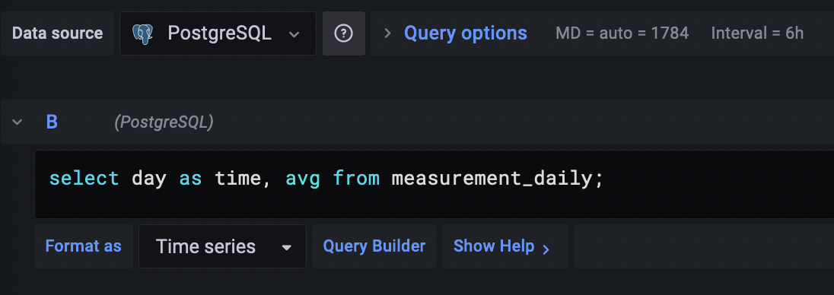
Notes:
Use when you want to display a couple smaller images or one big one

Slide 33
-
Continuous aggregates
Code sample
CREATE MATERIALIZED VIEW measurement_daily
WITH (timescaledb.continuous) AS
SELECT
time_bucket('1 day', "time") AS day,
avg(sensor_value) AS avg,
count(sensor_value) AS count
FROM measurement
GROUP BY day;
SELECT day AS time, avg FROM measurement_daily;
Notes:
Alternate light version for displaying code snippets.

Slide 34
-
Compression
Code sample
ALTER TABLE measurement SET (
timescaledb.compress,
timescaledb.compress_orderby = 'time DESC',
timescaledb.compress_segmentby = 'sensorID'
);
SELECT add_compression_policy('measurement', INTERVAL '1 month');
Up to 94% compression!
Notes:
Alternate light version for displaying code snippets.

Slide 35
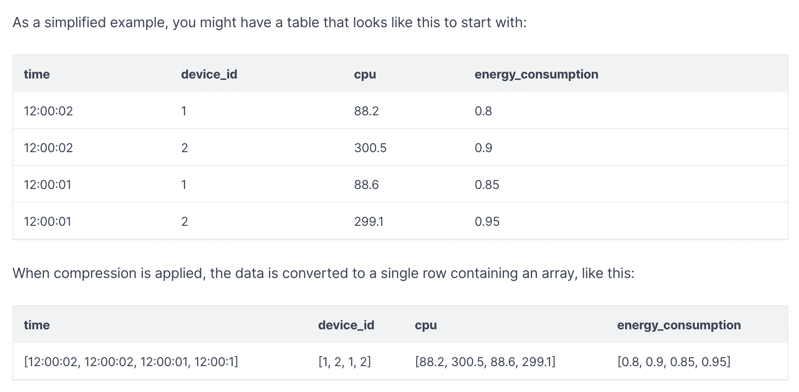
-
Compression
Code sample
Notes:
Alternate light version for displaying code snippets.

Slide 36
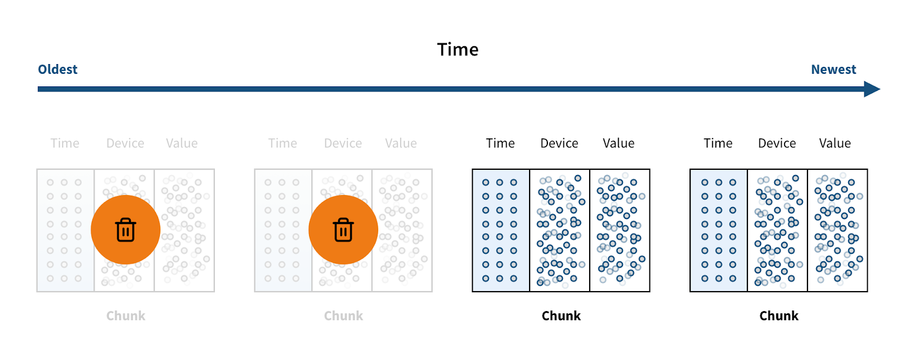

-
Data Retention
Code sample
SELECT add_retention_policy('measurement', INTERVAL '5 years');
Notes:
Alternate light version for displaying code snippets.

Slide 37
Timescale Cloud
TimescaleDB in the cloud
Notes:
This is an internal cover. Used when you need large text and it is not a section header. E.g. “Welcome” “Questions?” “Thank you!” “Shout Outs” etc
Font: Inter bold + navy recommended

Slide 38
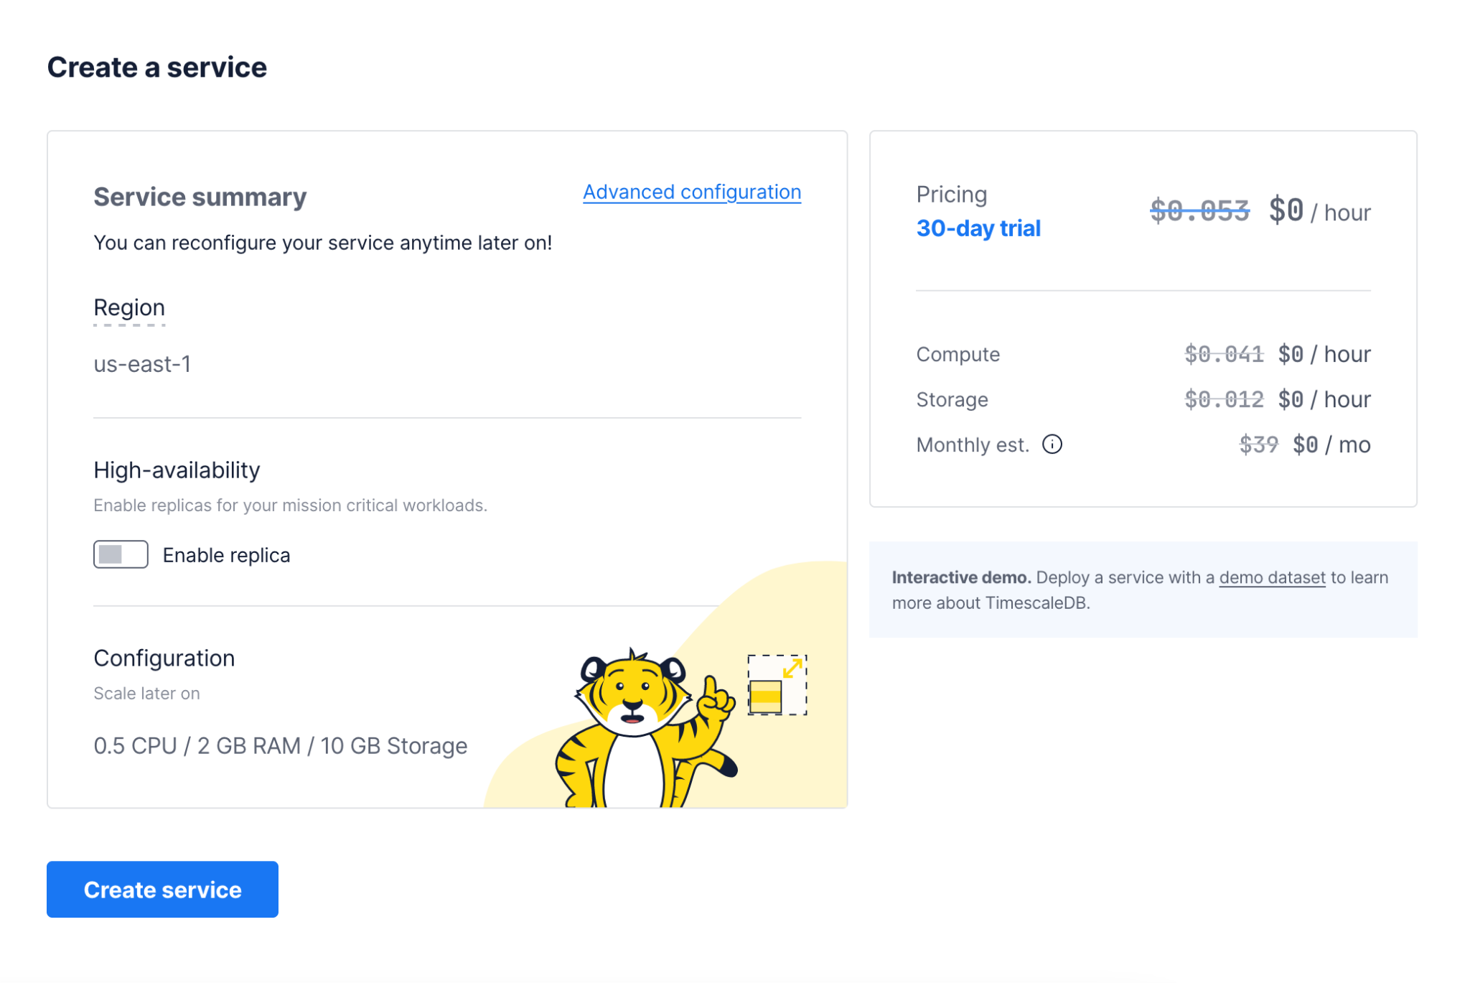
Timescale Cloud
Code sample
Notes:
Alternate light version for displaying code snippets.

Slide 39
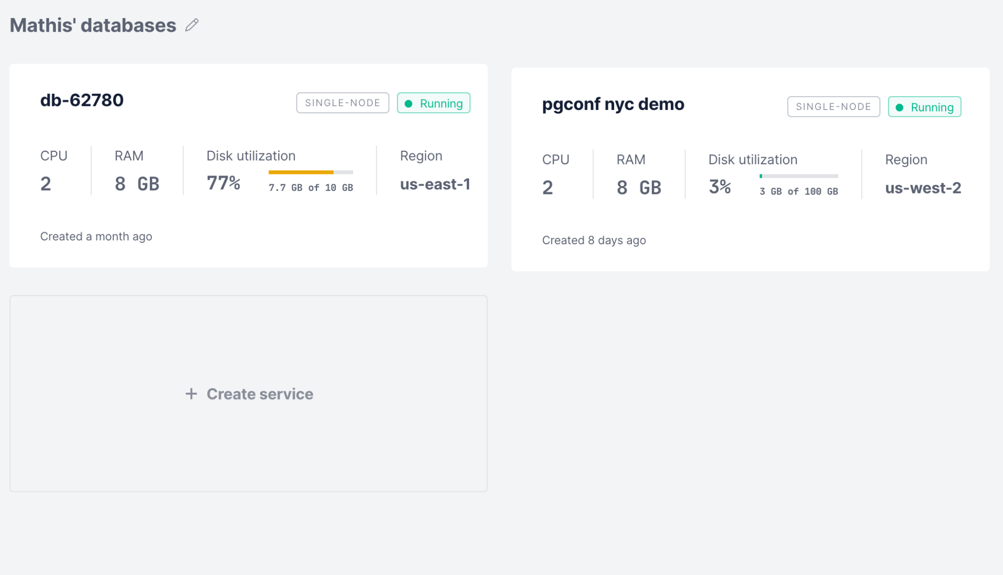
Timescale Cloud
Code sample
Notes:
Alternate light version for displaying code snippets.

Slide 40
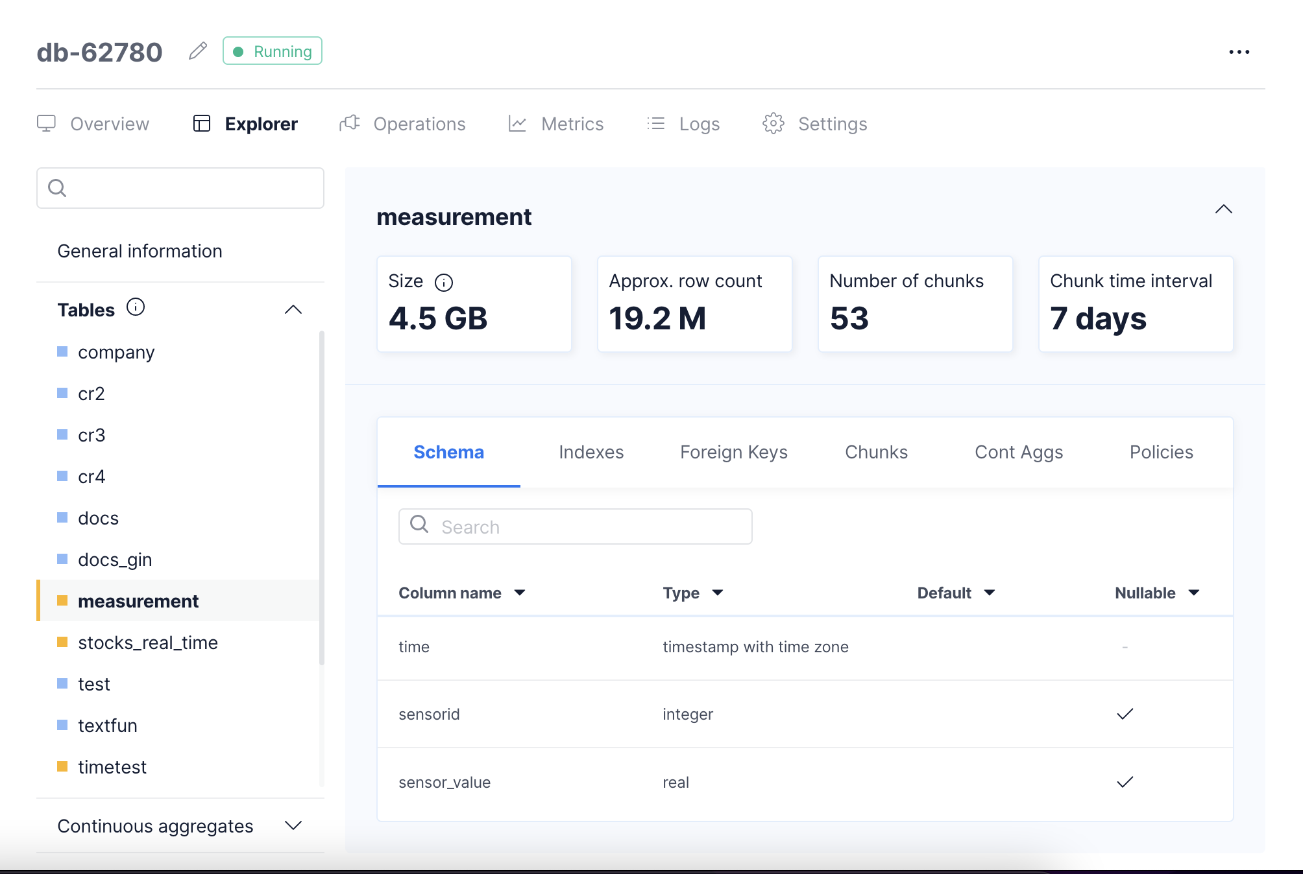
Timescale Cloud
Code sample
Notes:
Alternate light version for displaying code snippets.

Slide 41
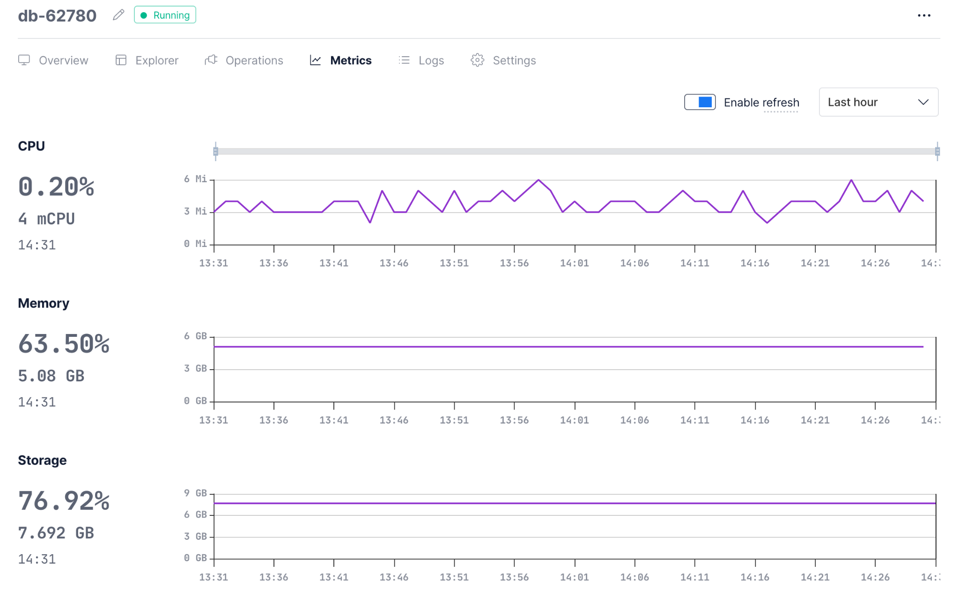
Timescale Cloud
Code sample
Notes:
Alternate light version for displaying code snippets.

Slide 42
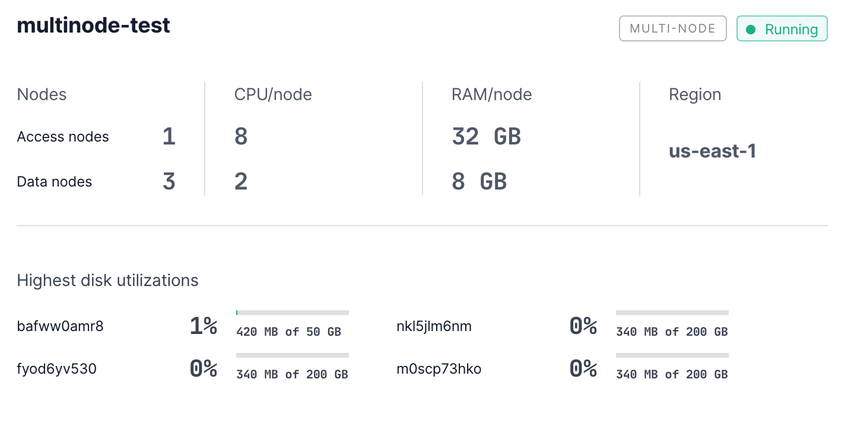
Timescale Cloud
Code sample
Notes:
Alternate light version for displaying code snippets.

Slide 43
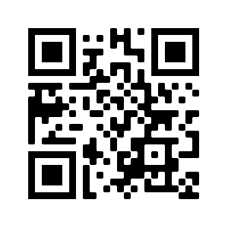

Questions?
Scan the QR code to visit the Timescale home page!
Notes:
Font: Inter bold + navy recommended

Slide 44
Thank you!
Scan the QR code to visit the Timescale home page!
Notes:
Font: Inter bold + navy recommended

